Slide 1
United International University
Department of Computer Science and Engineering
Course Name: Structured Programming Language Laboratory
Course Code: CSE 1112
Project Name: StudentHub is A C-Based Student Management System
Effortless Management of Student Records
Course instructor: Anika Tasnim Rodela
Presented By:
Rakibul Hasan Rabbi-0112330255
Arnab Karmokar Surid-0112331039

Slide 2
Project Overview
Objective: Manage and analyze student data using C and CSV files.
Key Features:
Load student data from a CSV file.
Display all records.
Search for a student by name.
Identify the top-performing student.
Find the most senior student.

Slide 3
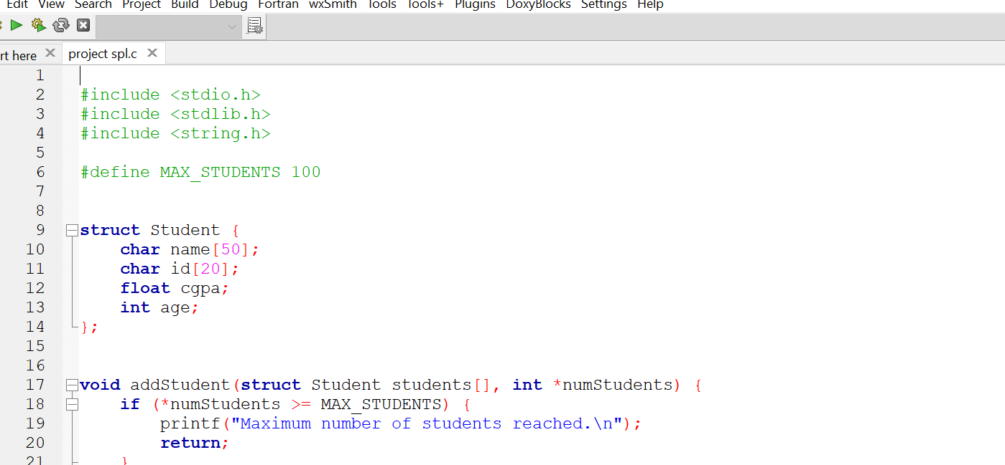
Key Features and Workflow
CSV Data Storage: Efficient storage in students.csv.
Interactive Menu: Commands for displaying, searching, and filtering data.
In-Memory Data Handling: Structures and arrays for efficient processing.

Slide 4
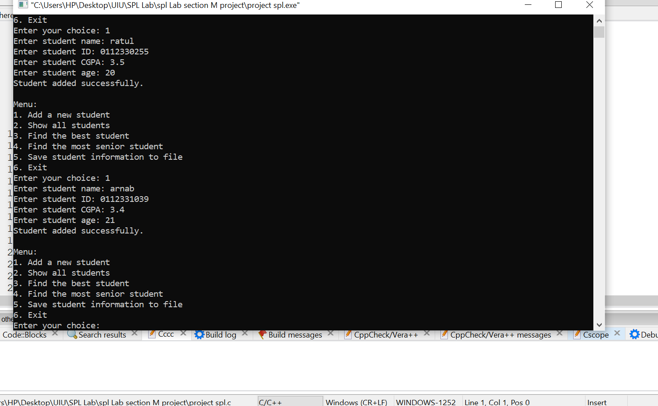
Sample Output
Example of menu and commands:
=== StudentHub ===
1. Display all students
2. Find the best student
3. Find the most senior student
4. Search student by name
5. Display students with grade above threshold
6. Exit
Enter your choice: 1

Slide 5
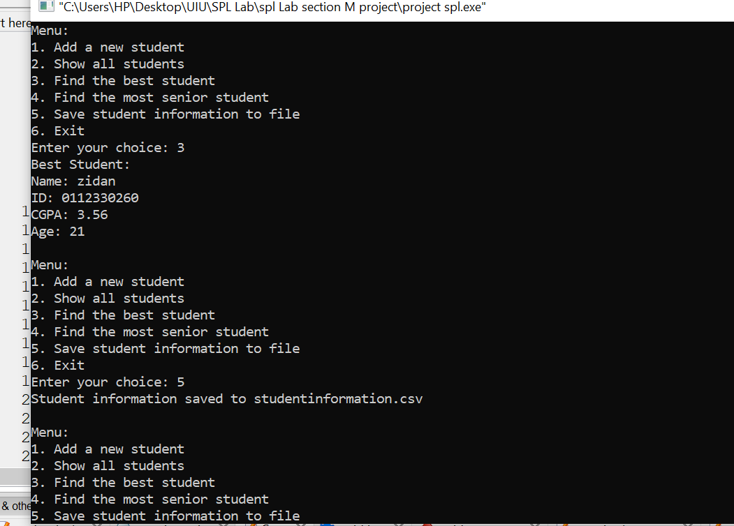
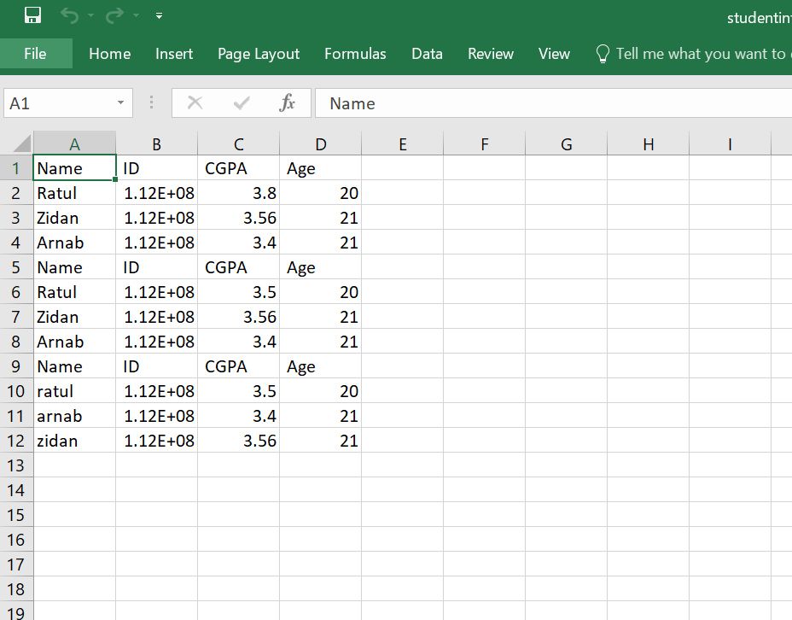
Sample output

Slide 6
Conclusion and Next Steps
Conclusion:
StudentHub simplifies managing student data with essential commands.
Demonstrates file handling, structures, and array manipulation in C.

